Slide 1
PA106/G/17570/22-ROBINS OBIRI
Homepage url -
https://f3uymnjmzyth5chay27eza.on.drv.tw/www.Beauty-Website.com/
About page url - https://f3uymnjmzyth5chay27eza.on.drv.tw/www.Beauty-Website.com/about.html
Login page url - https://f3uymnjmzyth5chay27eza.on.drv.tw/www.Beauty-Website.com/login.html
Sign page url - https://f3uymnjmzyth5chay27eza.on.drv.tw/www.Beauty-Website.com/SignUp.html
Contact page url - https://f3uymnjmzyth5chay27eza.on.drv.tw/www.Beauty-Website.com/contact.html

Slide 2
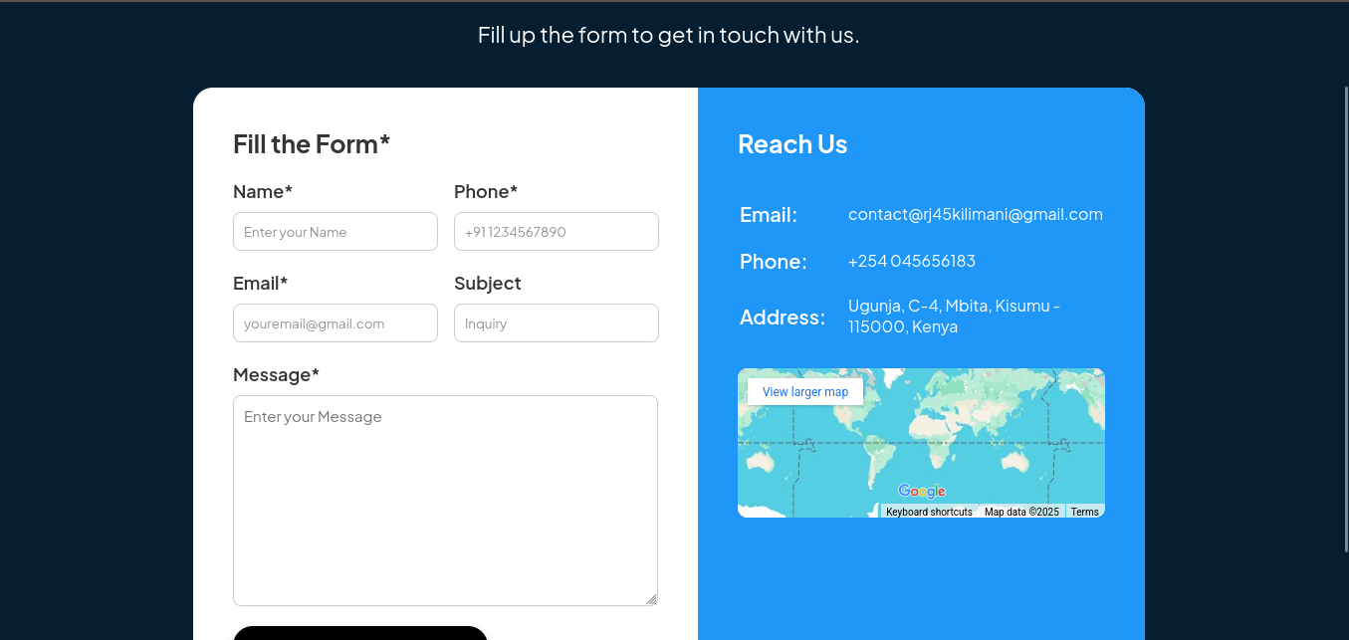
Screenshots

Slide 3
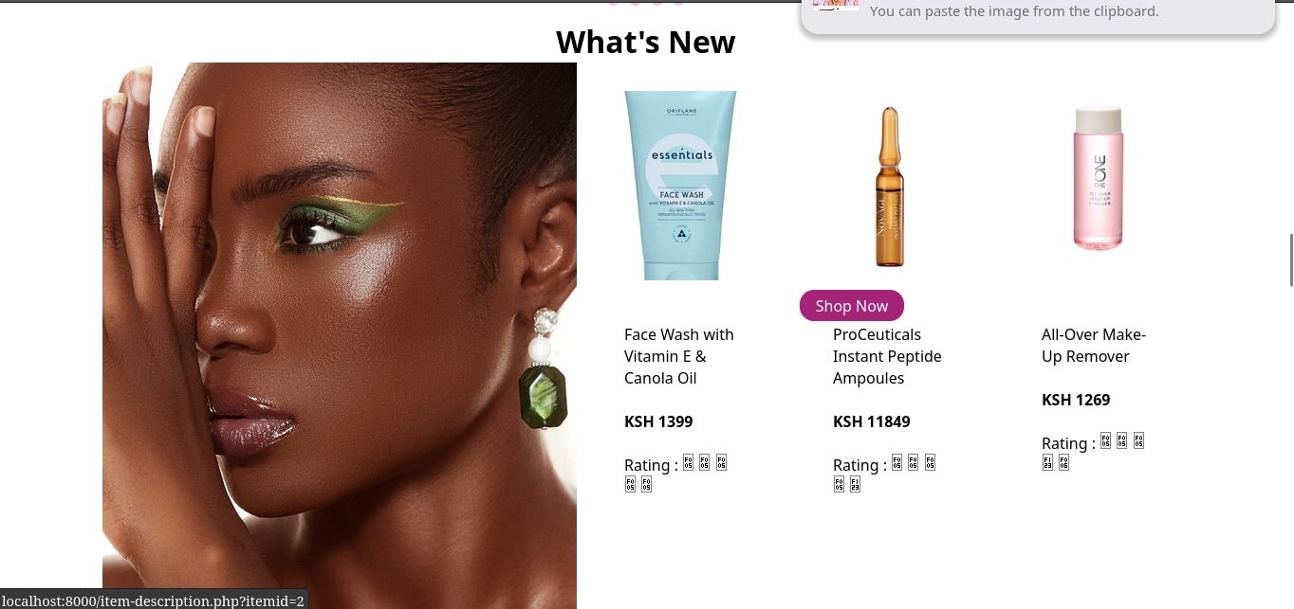

Slide 4


Slide 5
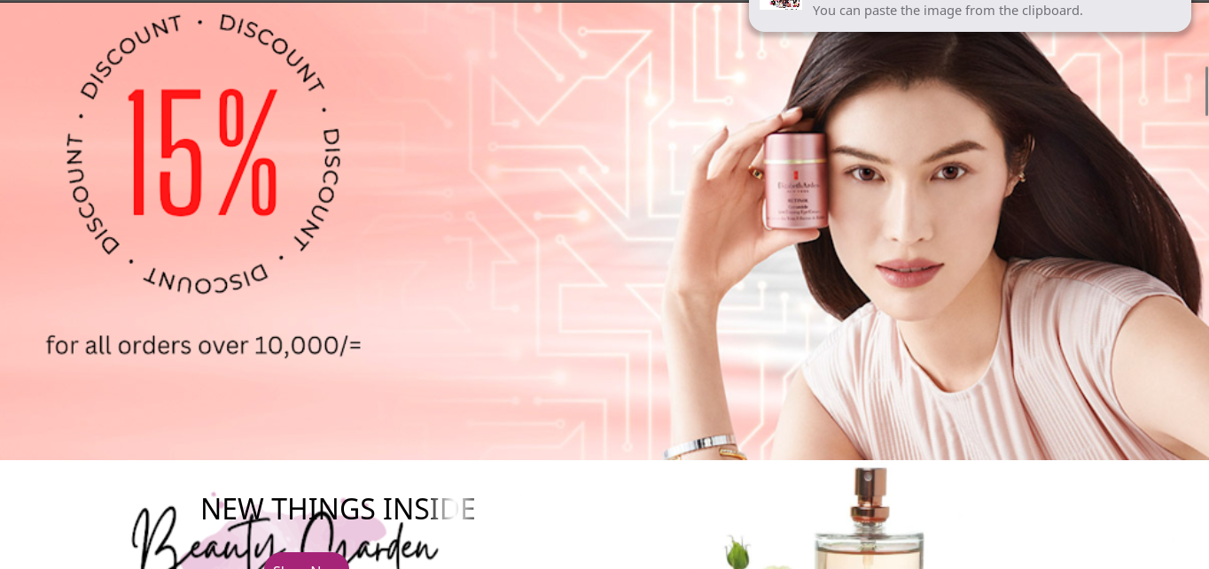

Slide 6
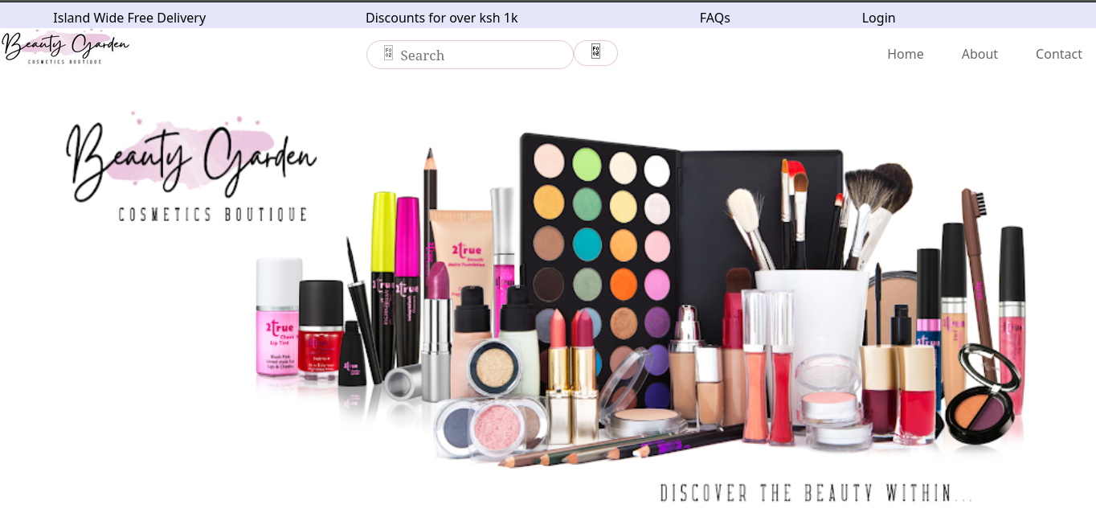

Slide 7
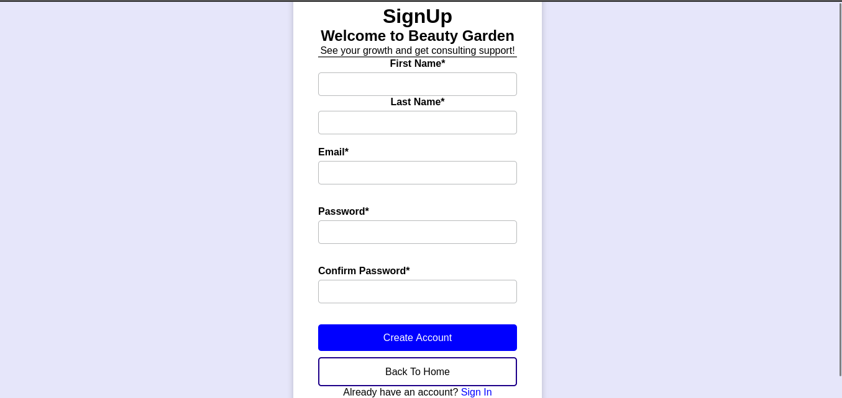

Slide 8
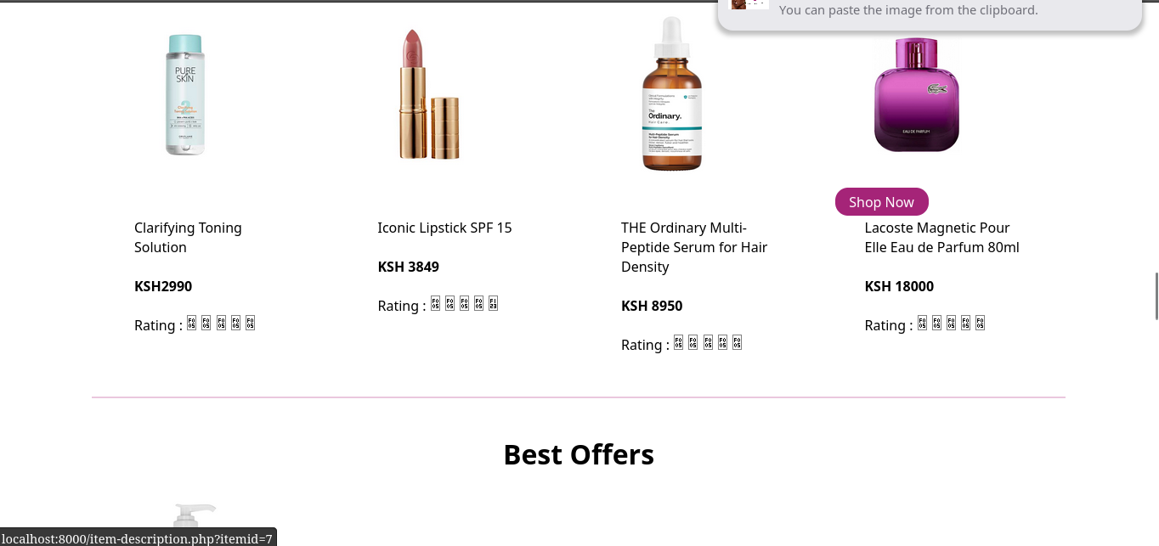

Slide 9
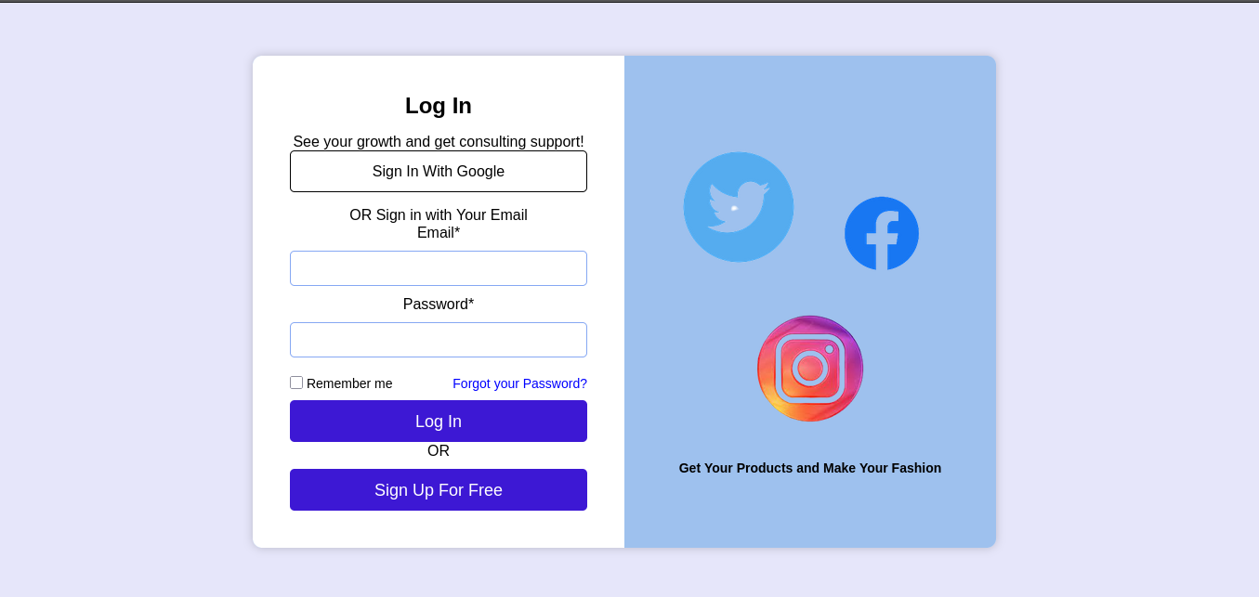

Slide 10
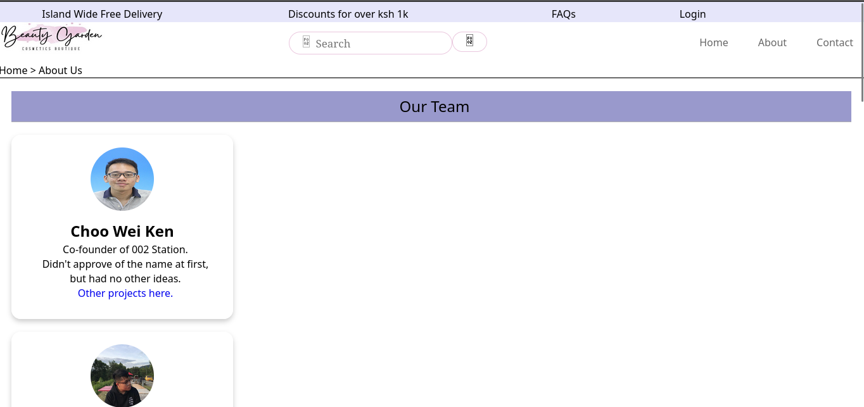

Slide 11
